Slide 1
Reducing Maternal Mortality Rates: A Data-Driven Approach
Using Data to Enhance Maternal Health

Slide 2
Sustainable Development Goal 3: Good Health and Well-being
Objective: Ensure healthy lives and promote well-being for all at all ages.
Focus Area: Reduce maternal mortality rates.
Significance: Maternal health is a critical indicator of health system effectiveness.

Slide 3
Identifying the problem
Specific Problem: High maternal mortality rates in rural and underserved areas.
Impact: Affects maternal and infant health, strains healthcare resources.
Goal: Use data to identify trends and improve healthcare services.

Slide 4
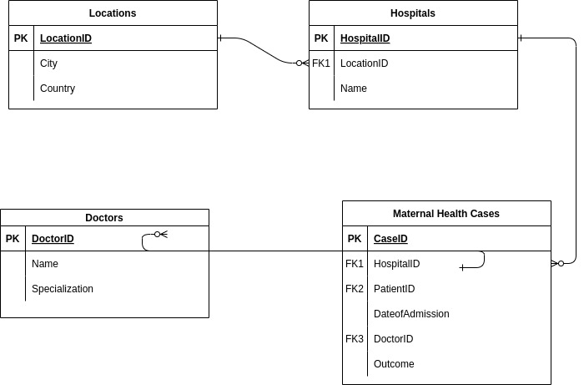
Database Design
ERD Overview: Diagram showing relationships between Locations, Hospitals, Doctors, Patient_Records, and Maternal_Health_Cases.

Slide 5
Database Schema
SQL Statements example:
CREATE TABLE Locations (
LocationID INT PRIMARY KEY,
City VARCHAR(255),
Country VARCHAR(255)
);
CREATE TABLE Hospitals (
HospitalID INT PRIMARY KEY,
Name VARCHAR(255),
LocationID INT,
FOREIGN KEY (LocationID) REFERENCES Locations(LocationID)
);

Slide 6
Sample Data
SQL Statements example:
CREATE TABLE Locations (
LocationID INT PRIMARY KEY,
City VARCHAR(255),
Country VARCHAR(255)
);
CREATE TABLE Hospitals (
HospitalID INT PRIMARY KEY,
Name VARCHAR(255),
LocationID INT,
FOREIGN KEY (LocationID) REFERENCES Locations(LocationID)
);

Slide 7
SQL Queries for Data Retrieval
SELECT
mh.CaseID,
p.PatientID,
p.Name AS PatientName,
h.HospitalID,
h.Name AS HospitalName,
l.City AS HospitalCity,
d.Name AS DoctorName,
mh.DateOfAdmission,
mh.Outcome
FROM Maternal_Health_Cases mh
JOIN Patient_Records p ON mh.PatientID = p.PatientID
JOIN Hospitals h ON mh.HospitalID = h.HospitalID
JOIN Locations l ON h.LocationID = l.LocationID
JOIN Doctors d ON mh.DoctorID = d.DoctorID;

Slide 8
Data Analysis Using Excel
Analysis Techniques:
Pivot Tables:
Created pivot tables to analyze maternal mortality rates by region and hospital.
Example: A pivot table showing the number of maternal health cases and mortality rates per hospital and location.
Charts and Graphs:
Bar Chart: Compare mortality rates across different hospitals.
Pie Chart: Distribution of outcomes (Survived vs. Fatal) across regions.
Line Graph: Trends in maternal health cases over time.

Slide 9
Excel Dashboard
Key Insights:
High-Risk Areas: The dashboard reveals specific areas with consistently high mortality rates, allowing for targeted public health campaigns.
Hospital Performance: Easily compare the performance of hospitals and identify those in need of additional support or resources.
Outcome Trends: Monitor changes in maternal health outcomes over time to assess the impact of any interventions or improvements.

Slide 10
Conclusion
Summary:
Impact of Data: By analyzing the data, we've identified key areas where maternal mortality rates are higher and pinpointed hospitals and regions in need of intervention.
Insights Gained: Data analysis has provided actionable insights into regional disparities, hospital performance, and trends over time, which are crucial for improving maternal health.

